Slide 1




ATLIQ HARDWARE
CONSUMER GOODS
AD-HOC ANALYSIS
Presented By : Kanchan Sinha

Slide 2
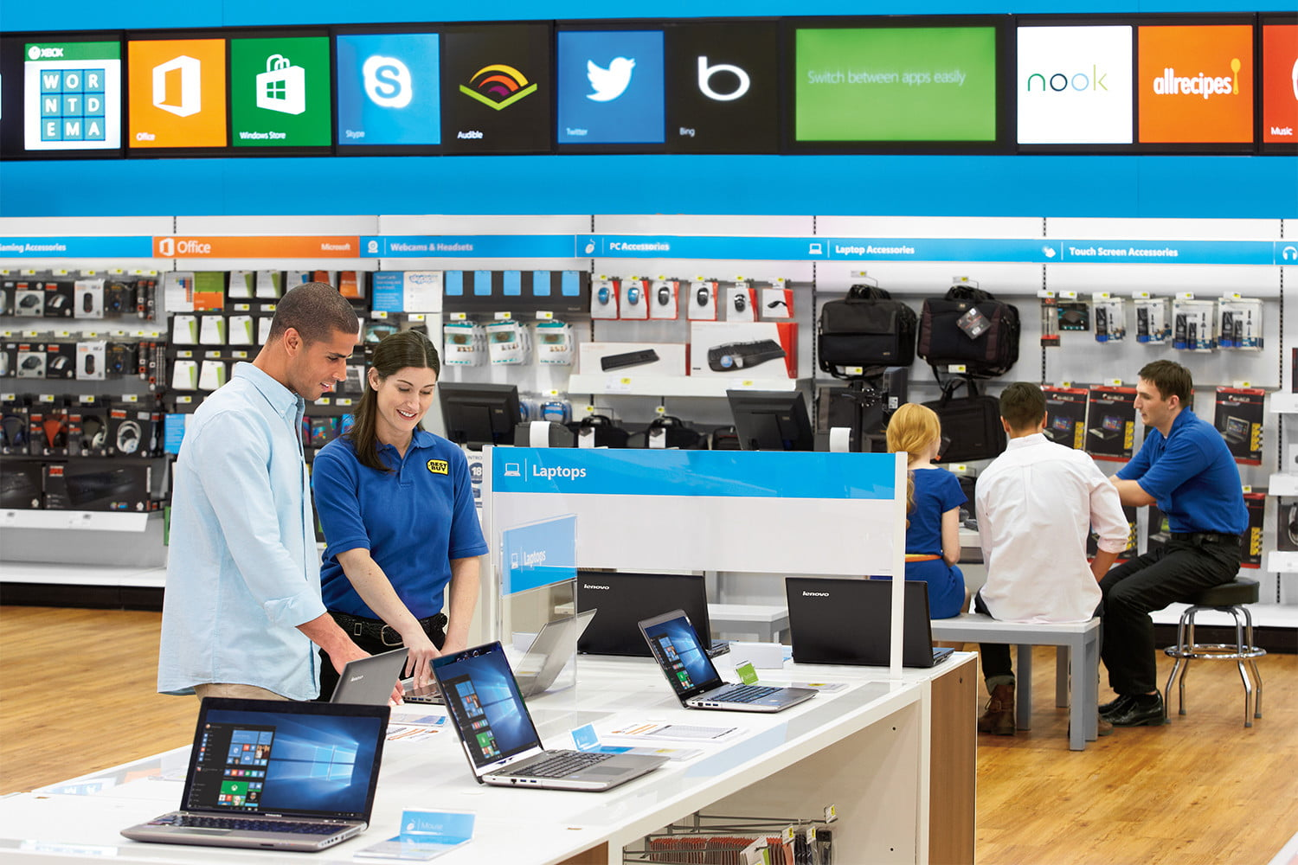

CONTENT
01
02
03
Company Overview
Business Model
Problem Statement
04
05
06
Objective
Analysis
Insights

Slide 3



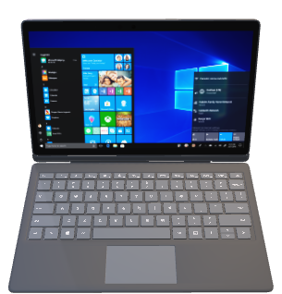
ABOUT US
AtliQ Hardware is a global supplier specializing in computers and their peripherals. The company is committed to providing high-quality hardware solutions that enhance productivity and user experience.
Fiscal Year starts in September

Slide 4


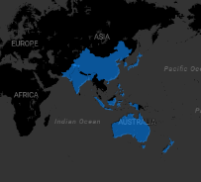
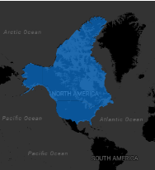
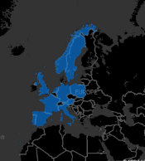
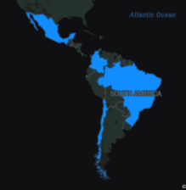
Platform Presence
Brick & Mortar
E- commerce

Slide 5






Neptune
e Store
exclusive
Retailer
Direct
Distributor

Slide 6




Problem Statement
AtliQ Hardware is struggling to quickly address specific business questions due to the limitations of its current reporting tool.
This causes delays in data-driven decisions in areas like sales, finance, and supply chain
To tackle this issue Team Leader has given 10 Ad hoc request to Data Analyst.

Slide 7




OBJECTIVES
Conduct analyses to generate quick, actionable insights that support data-driven decisions across key areas, including sales, finance, marketing, and supply chain, ultimately enhancing overall business performance.
Additionally, present these insights to the newly appointed department head.

Slide 8
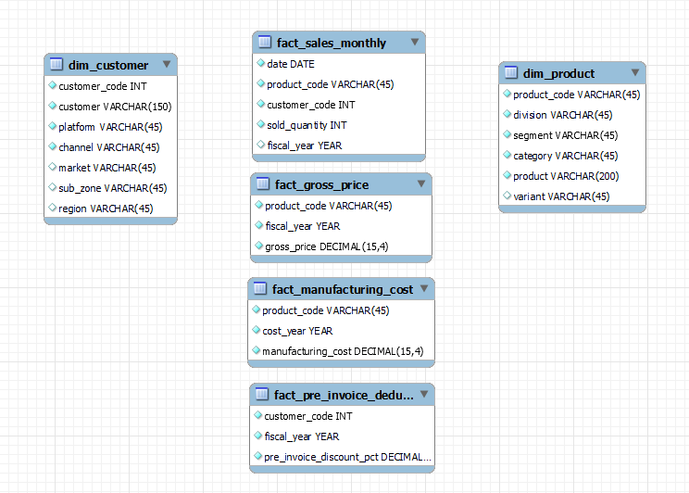
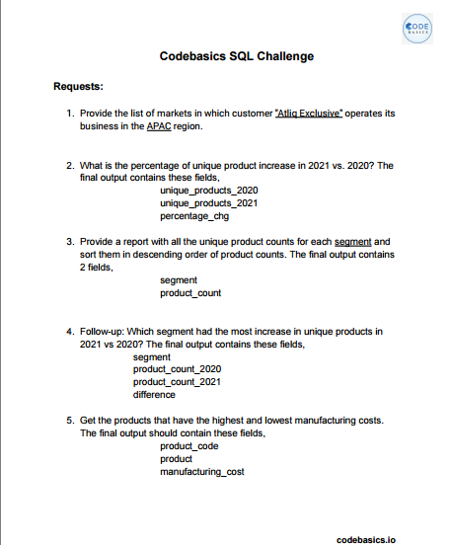
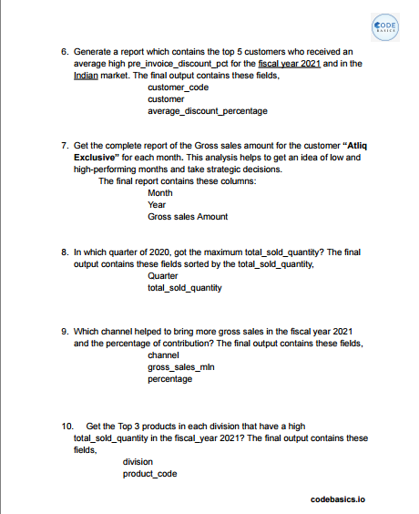
Database & Ad hoc Requests

Slide 9
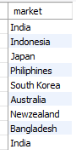

1. Provide the list of markets in which customer "Atliq Exclusive" operates its business in the APAC region.
Insights
Out of 17 markets for Atiq exclusive 9 are from APAC region.
A significant portion of Atiq Exclusive’s market is concentrated in the APAC region, indicating its importance in the company's overall strategy.
Potential to deepen market penetration and tailor strategies to APAC consumer preferences.
APAC: Asia Pacific region

Slide 10
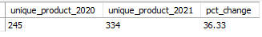
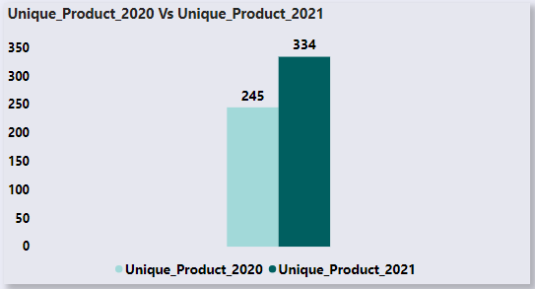

2. What is the percentage of unique product increase in 2021 vs. 2020? The final output contains these fields: unique_products_2020, unique_products_2021, percentage_change
Insights
The 36.3% increase in unique products may indicate that the company is investing in R&D and product innovation, leading to the introduction of new products to the market.
This could also suggest the company is expanding into new markets or targeting new customer segments with a broader product range.
36.3%

Slide 11
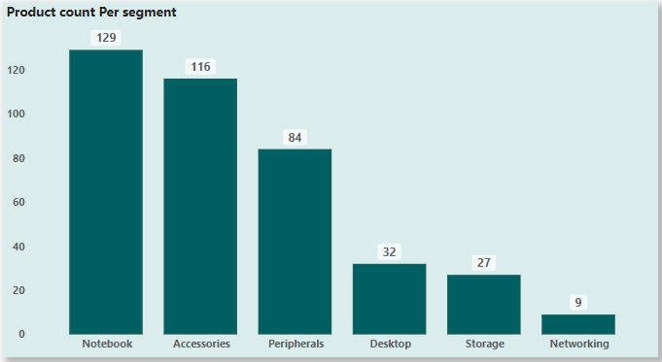
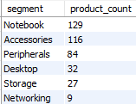
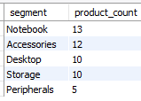
3. Provide a report with all the unique product counts for each segment and sort them in descending order of product counts. The final output contains : segment, product_count.
Unique Products
Unsold Products

Slide 12
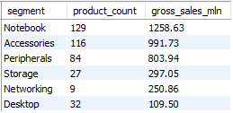
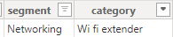
Insights
The notebook is performing well in terms of both the number of products sold and gross sales.
Although there are only 9 unique networking products, they surpass desktops in terms of gross sales.
Additionally, every product in the lineup is selling well, with none underperforming.
A device that increases the range of a Wi-Fi network by rebroadcasting the signal from a router to areas that have poor or no Wi-Fi coverage.

Slide 13
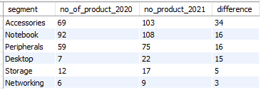
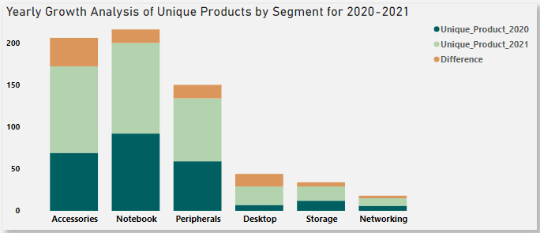
4. Follow-up: Which segment had the most increase in unique products in 2021 vs 2020? The final output contains these fields: segment, product_count_2020, product_count_2021, difference
Insights
High product count growth indicates strong market demand and frequent innovation.
Likely driven by competitive consumer needs and shorter product lifecycles.
Low product count growth is driven by longer product cycles, which align with enterprise-focused products that have steady demand.

Slide 14
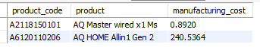
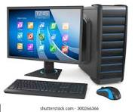

5. Get the products that have the highest and lowest manufacturing costs. The final output should contain these fields: product_code product, manufacturing_cost
Highest Manufacturing Cost
240.53
Lowest Manufacturing Cost
0.89
AQ Home Allin 1 Gen 2
AQ Master wired x1 MS

Slide 15
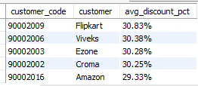
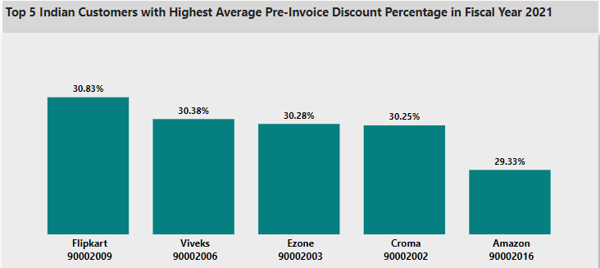
6. Generate a report which contains the top 5 customers who received an average high pre_invoice_discount_pct for the fiscal year 2021 and in the Indian market. The final output contains these field: customer_code, customer, average_discount_percentage.
Insights
The company giving almost equal discounts to its top 5 customers reflects a consistent and fair pricing strategy aimed at fostering strong relationships.
This approach also ensures competitiveness across both online and offline channels while driving sales volume.

Slide 16
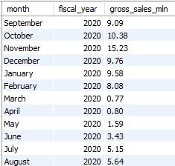
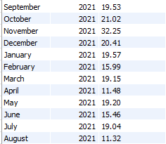
7. Get the complete report of the Gross sales amount for the customer “Atliq Exclusive” for each month. This analysis helps to get an idea of low and high-performing months and take strategic decisions. The final report contains these columns: Month, Year, Gross sales Amount
Insights
Strong Q1 Peaks: Each fiscal year begins with high sales, with 2021 showing a significant increase—September sales nearly doubled compared to the previous year.
In March-April 2020, gross sales dropped below 1 million due to the impact of COVID-19. However, sales gradually began to recover in the following months.

Slide 17
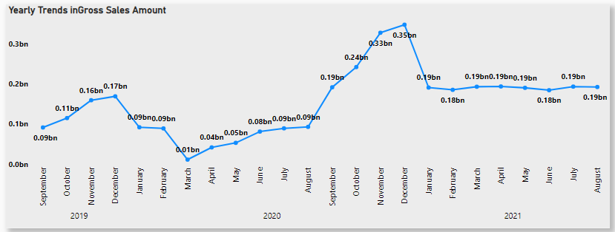

Slide 18
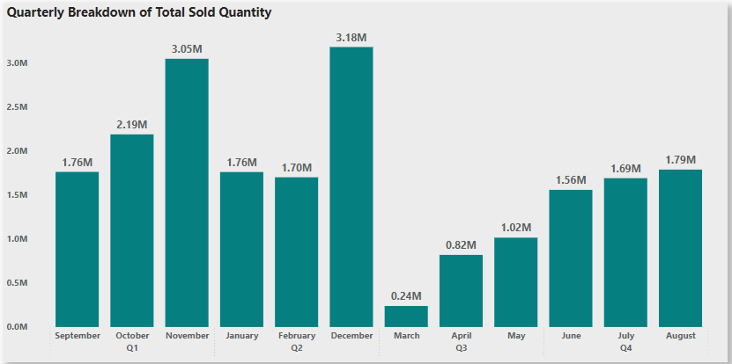
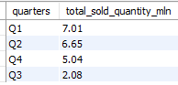
8. In which quarter of 2020, got the maximum total_sold_quantity? The final output contains these fields sorted by the total_sold_quantity, Quarter, total_sold_quantity.
Insights
The company began the year with high sales volumes, but in the third quarter, sales sharply declined due to the COVID-19 outbreak. However, sales gradually rebounded in the following quarter.

Slide 19
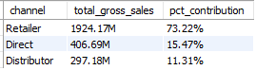
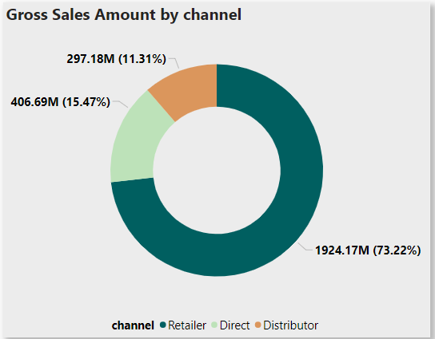
9. Which channel helped to bring more gross sales in the fiscal year 2021and the percentage of contribution? The final output contains these fields: channel, gross_sales_mln, percentage.
Insights
Retailers account for 73.22% of sales, making them the primary revenue driver. This dominance suggests strong consumer preference for this channel.
Invest in marketing campaigns and training for the Direct Sales team to increase their effectiveness. Explore partnerships with Retailers to enhance brand visibility.

Slide 20
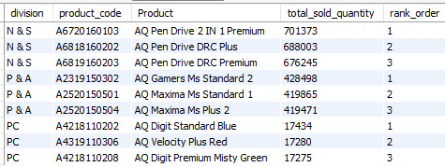
10. Get the Top 3 products in each division that have a high total_sold_quantity in the fiscal_year 2021? The final output contains these fields: division product_code, product, total_sold_quantity, rank_order.
Insights
The N&S segment favors premium pen drives, indicating demand for quality and supporting higher pricing strategies.
The P&A segment favors affordable, functional mouse models, especially for gamers, highlighting demand for competitively priced basics.
The PC segment shows niche demand, with top products differing mainly in minor features, indicating a lower volume market..

Slide 21
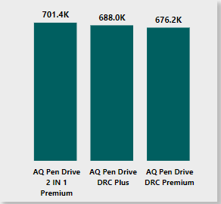
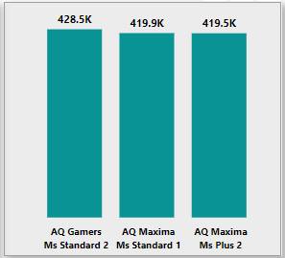

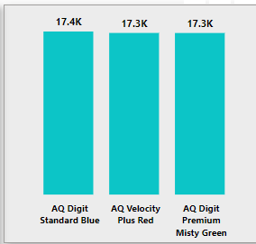


N & S
P & A
PC
N & S : Network & Storage P & A : Peripherals and Accessories PC : Personal Computer

Slide 22



Thank You

